Slide 1
Java Programming
4

Slide 2
Interface in Java
An interface in Java is a blueprint of a class. It has static constants and abstract methods.
The interface in Java is a mechanism to achieve abstraction. There can be only abstract methods in the Java interface, not method body. It is used to achieve abstraction and multiple inheritance in Java.
In other words, you can say that interfaces can have abstract methods and variables. It cannot have a method body.
Java Interface also represents the IS-A relationship.

Slide 3
Java Interface
There are mainly three reasons to use interface. They are given below.
It is used to achieve abstraction.
By interface, we can support the functionality of multiple inheritance.
It can be used to achieve loose coupling.
How to declare an interface?
An interface is declared by using the interface keyword. It provides total abstraction; means all the methods in an interface are declared with the empty body, and all the fields are public, static and final by default. A class that implements an interface must implement all the methods declared in the interface.
Syntax:
interface <interface_name>{
// declare constant fields
// declare methods that abstract
// by default.

Slide 4
Inner Class in Java
Java inner class or nested class is a class that is declared inside the class or interface.
We use inner classes to logically group classes and interfaces in one place to be more readable and maintainable.
Additionally, it can access all the members of the outer class, including private data members and methods.

Slide 5
Syntax of Inner class
class Java_Outer_class{
//code
class Java_Inner_class{
//code
}
}
There are certain advantages associated with inner classes are as follows:
Making code clean and readable.
Private methods of the outer class can be accessed, so bringing a new dimension and making it closer to the real world.
Optimizing the code module.

Slide 6
Types of Inner Classes
There are basically four types of inner classes in java.
Nested Inner Class
Method Local Inner Classes
Static Nested Classes
Anonymous Inner Classes
Nested Inner Class:
It can access any private instance variable of the outer class. Like any other instance variable, we can have access modifier private, protected, public, and default modifier. Like class, an interface can also be nested and can have access specifiers.
Method Local Inner Classes:
Inner class can be declared within a method of an outer class which we will be illustrating in the below example where Inner is an inner class in outerMethod().

Slide 7
Static Nested Class
It Static nested classes are not technically inner classes. They are like a static member of outer class.
Anonymous inner classes
Anonymous inner classes are declared without any name at all. They are created in two ways.
As a subclass of the specified type
As an implementer of the specified interface

Slide 8
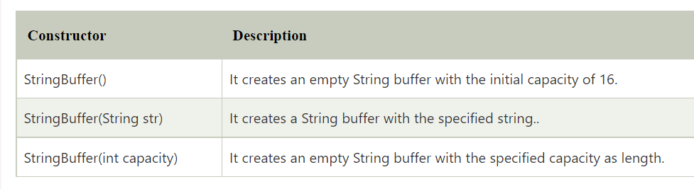
Java StringBuffer Class
Java StringBuffer class is used to create mutable (modifiable) String objects. The StringBuffer class in Java is the same as String class except it is mutable i.e. it can be changed.

Slide 9
What is a mutable String?
A String that can be modified or changed is known as mutable String. StringBuffer and StringBuilder classes are used for creating mutable strings.
1) StringBuffer Class append() Method
The append() method concatenates the given argument with this String.
2) StringBuffer insert() Method
The insert() method inserts the given String with this string at the given position.
3) StringBuffer replace() Method
The replace() method replaces the given String from the specified beginIndex and endIndex.
4) StringBuffer capacity() Method
The capacity() method of the StringBuffer class returns the current capacity of the buffer. The default capacity of the buffer is 16. If the number of character increases from its current capacity, it increases the capacity by (oldcapacity*2)+2. For example if your current capacity is 16, it will be (16*2)+2=34.
}

Slide 10
StringTokenizer in Java
StringTokenizer
Methods of StringTokenizer
The java.util.StringTokenizer class allows you to break a String into tokens. It is simple way to break a String. It is a legacy class of Java.
It doesn't provide the facility to differentiate numbers, quoted strings, identifiers etc. like StreamTokenizer class. We will discuss about the StreamTokenizer class in I/O chapter.
In the StringTokenizer class, the delimiters can be provided at the time of creation or one by one to the tokens.

Slide 11
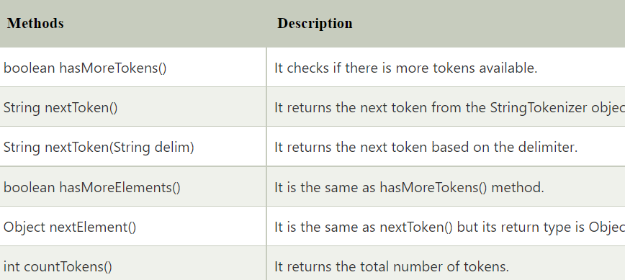
String Tokenizer Methods

